Slide 1



Introduction
Copyright in the Digital Environment
Amy Thomas
14 January 2026

Slide 2
Format: 14 January
First half: Introduction to the course
Second half: 20 Years of Copyright Wars
Note on timings: as a general rule, we will have a shorter mid-class break (5 mins) and finish earlier (e.g., 16:50ish)

Slide 3
Teaching team
Course Convenor | Amy Thomas amy.thomas@glasgow.ac.uk
Course Lecturer(s) | Amy Thomas Martin Kretschmer (AI: inputs) Kris Erickson (AI: outputs)

Slide 4
Intended learning outcomes
Copyright as a law regulating creativity with implications for culture and commerce
UK/EU focus (with applicable Brexit disclaimer)
Practical applications of copyright law
Thinking critically
Extrapolate the application of the law to other social/political/economical issues

Slide 5
Overview of topics
1 | 14 January | Introduction / 20 years of copyright wars [AT]
2 | 21 January | Overview of UK Copyright Law 1 / Authorship, ownership and subject matter [AT]
3 | 28 January | Overview of UK Copyright Law 2 / Exclusive rights [AT]
4 | 4 February | Overview of UK Copyright Law 3 / Exceptions and limitations [AT]
5 | 11 February | Infringement, streaming and piracy [AT]
6 | 18 February | Performers’ rights [AT]
7 | 25 February | Creators’ earnings and contracts [AT]
8 | 4 March | AI: Inputs and licensing economy [MK]
9 | 11 March | AI: Outputs and creativity [KE]
10 | 18 March | Revision [AT]
Important note to check the room/location ahead of time!

Slide 6
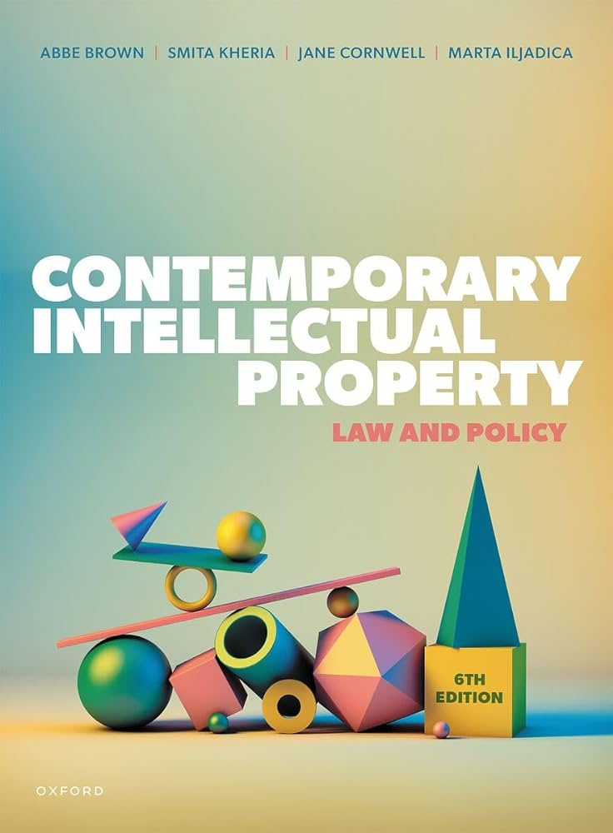
Course materials
Essential (core) and recommended (optional) Essential reading: Brown, Kheria, Cornwell and Iljadica (2024) Contemporary Intellectual Property: Law and Policy (6th Edition) OR Bently, Sherman, Gangjee and Johnson (2022) Intellectual Property Law (6th Edition)
‘Discussion Questions’ – help to focus your attention on the important ‘message’ from the readings
Slides will be made available on the Moodle page 24 hours before the relevant lecture

Slide 7
Student voice (24/25 feedback)
Some students wanted more recommended readings -> I will continue to add readings throughout the course depending on students’ interests/needs + we’ll talk about how to source/research good scholarship
Mid-term survey/check-in

Slide 8
Grading and assignment
1. An essay of 4,500 words
Worth 85% of your overall grade
Students will be permitted to choose from a range of questions based on course topics
Due date: TBC
Students will have the opportunity to submit a formative assignment (ungraded) in the form of an essay plan/outline ahead of the revision class for feedback (due date TBC)

Slide 9
Grading and assignment
2. Participation
Worth 15% of your overall grade
Via digital activities (e.g., Microsoft Forms, Moodle, Padlet)
Time will be given to complete the activity in class, but this can also be completed up to one week after the class (e.g., if you have an absence due to illness, you can still participate remotely)
IMPORTANT: accessibility requirements and reasonable adjustments (contact me if you have concerns)

Slide 10
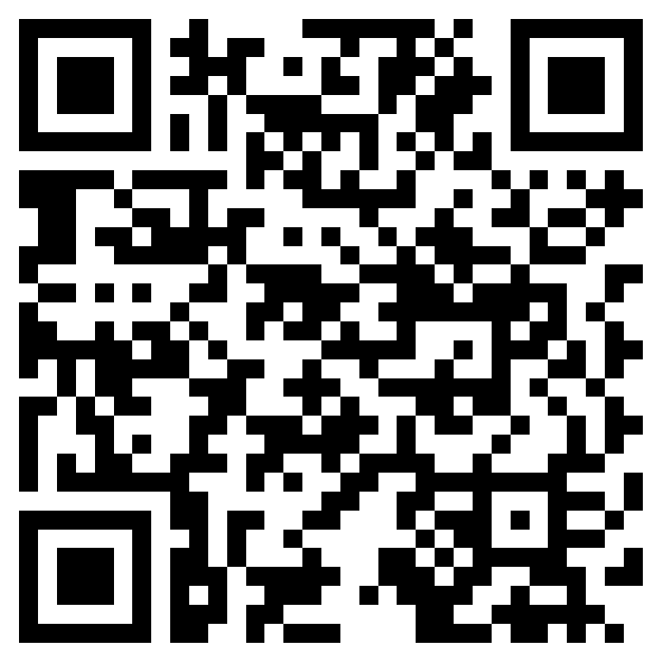
Your first participation activity!
Please share an example of something that you think would be interesting to explore in this class. It can be anything you think implicates copyright in your life or interests/hobbies. Feel free to share a link if it's helpful to illustrate your example.
https://forms.cloud.microsoft/e/ZFeAyGFwrp

Slide 11
20(+?) Years of Copyright Wars
Copyright in the Digital Environment
Amy Thomas
14 January 2026

Slide 12
What is the copyright ‘war’ about?
For discussion: Why is copyright controversial? Why do people protest about changes to copyright policy?

Slide 13
What is the copyright ‘war’ about?
Do key stakeholders in copyright want the same things? For example:
Creators
Rightsholders
Users
Pirates
Platforms
Maximalist
Minimalist
Abolitionist

Slide 14
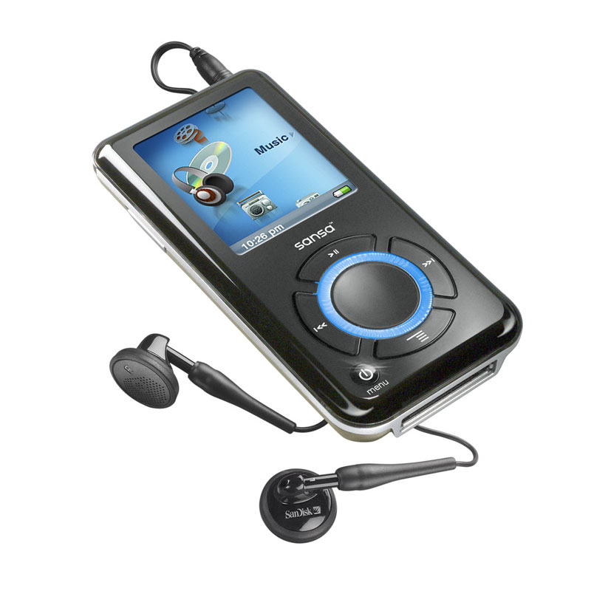
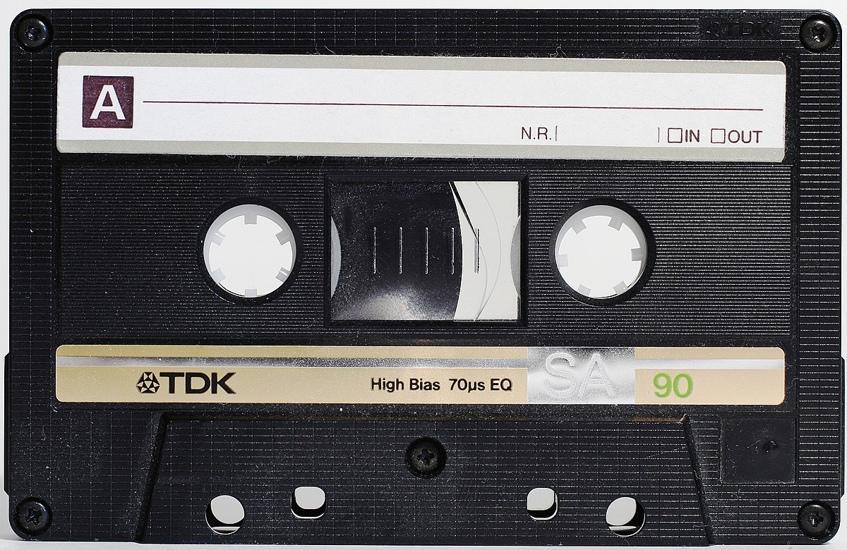
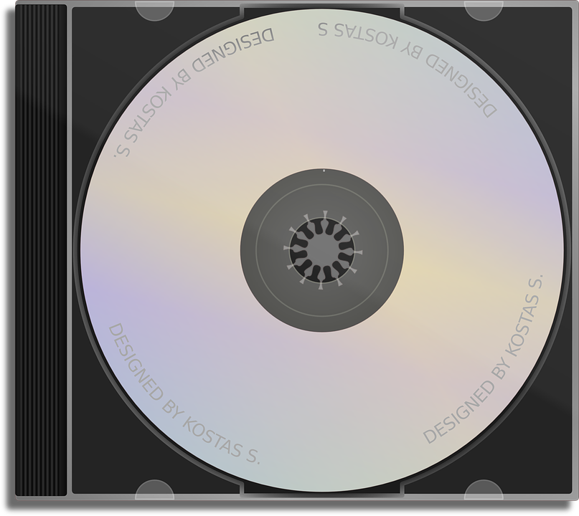
Late 90s/early 00s: Analogue - digital

Slide 15
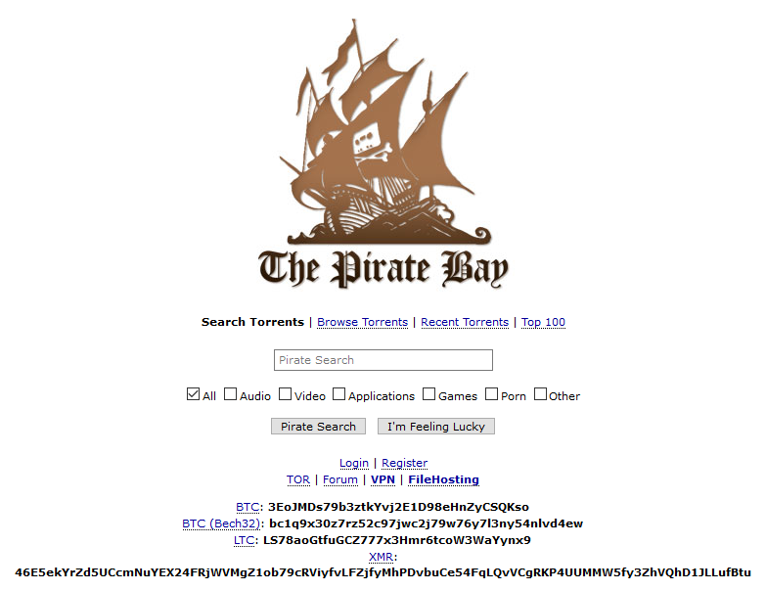
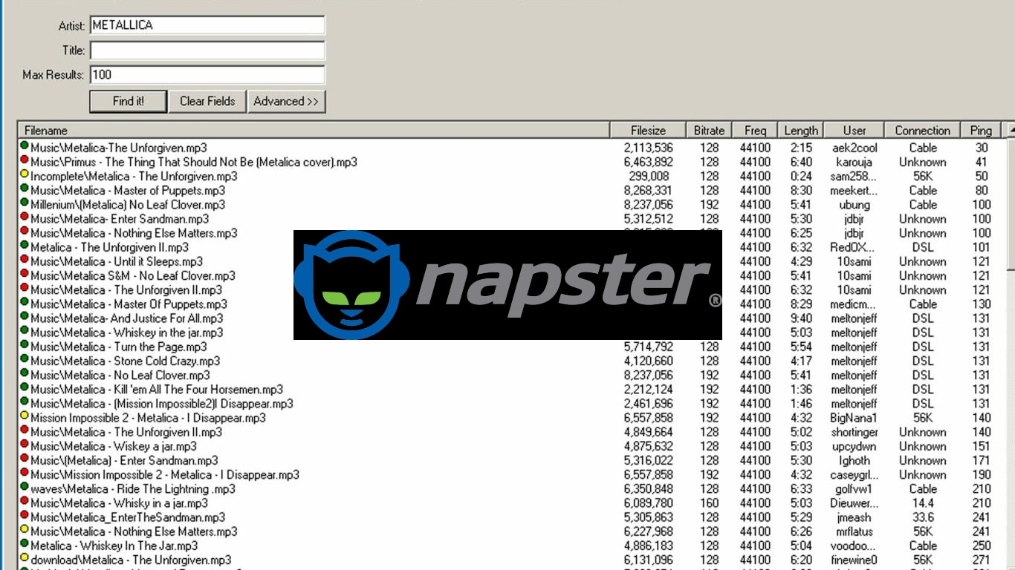
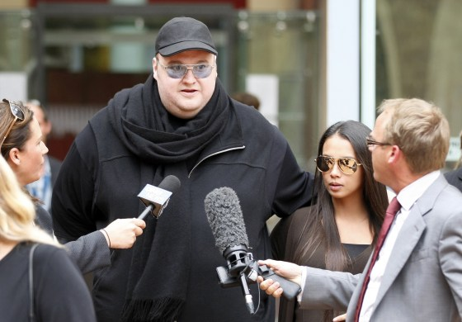
Late 90s/early 00s: ‘P2P’ platforms

Slide 16
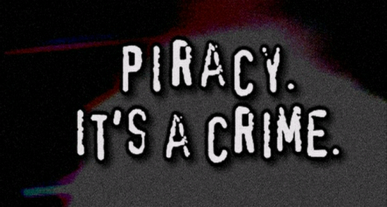
‘You wouldn’t steal a car’ (Federation Against Copyright Theft and MPA), 2004
Do you agree with this statement? Why / why not?
What effect is this statement intended to have, and to whom? (how would it make you feel?)
What are the interests of the people writing the message?

Slide 17
Late 90s/early 00s: Position mapping
Maximalist
Minimalist
Abolitionist
Rightsholders
(particularly record companies)
Creators
(or rather, a more moderate position)
Pirates and P2P platforms

Slide 18
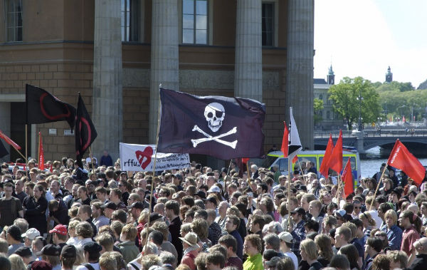
2009: Pirate Bay conviction (EU)
Public protests in Stockholm (Swedish court) against the conviction of Pirate Bay leaders (fine and imprisonment)
“The establishment and the politicians have declared war against our whole generation,” he said, calling on “file-sharing for the people.”

Slide 19
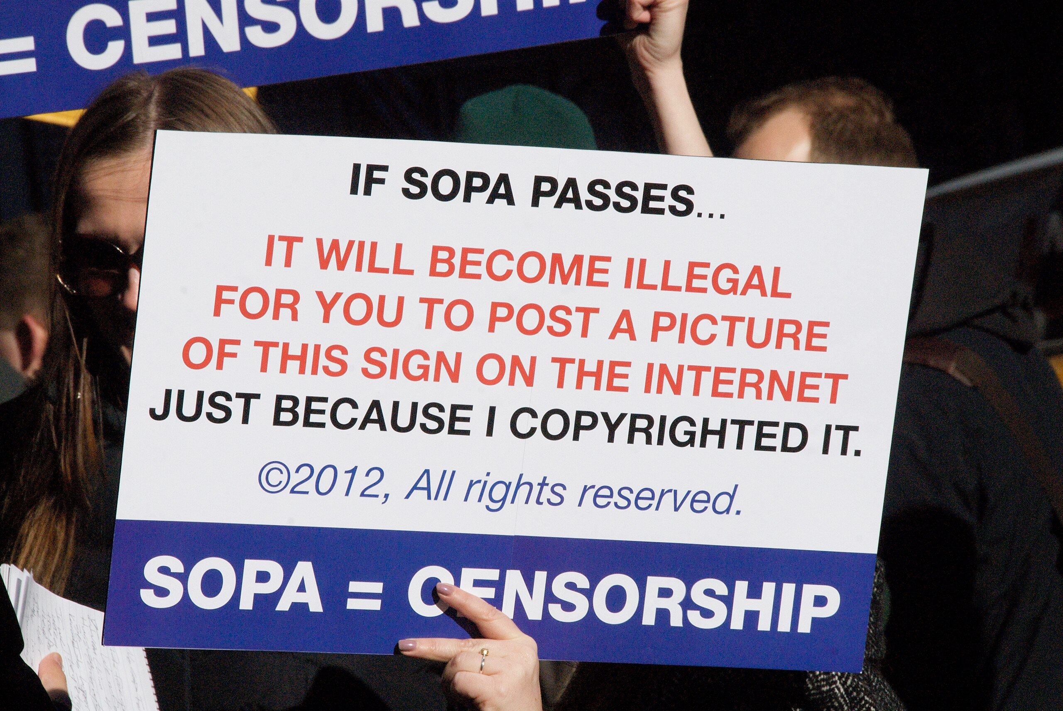
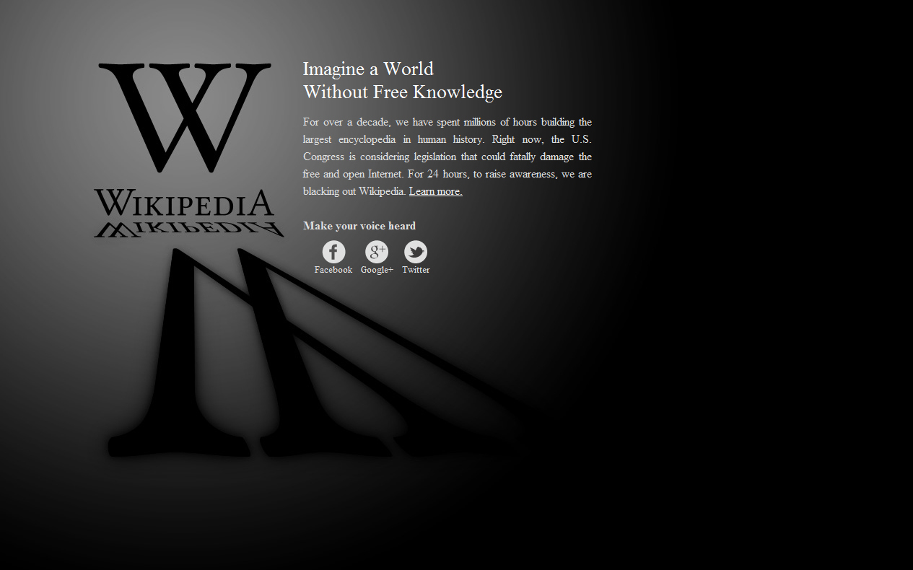
2012: SOPA/PIPA (US)
Public protests and website ‘blackouts’
The bills proposed that anyone found guilty of streaming copyrighted content without permission 10 or more times within six months should face up to five years in jail.
The US government and rights holders would have the right to seek court orders against any site accused of "enabling or facilitating" piracy.

Slide 20
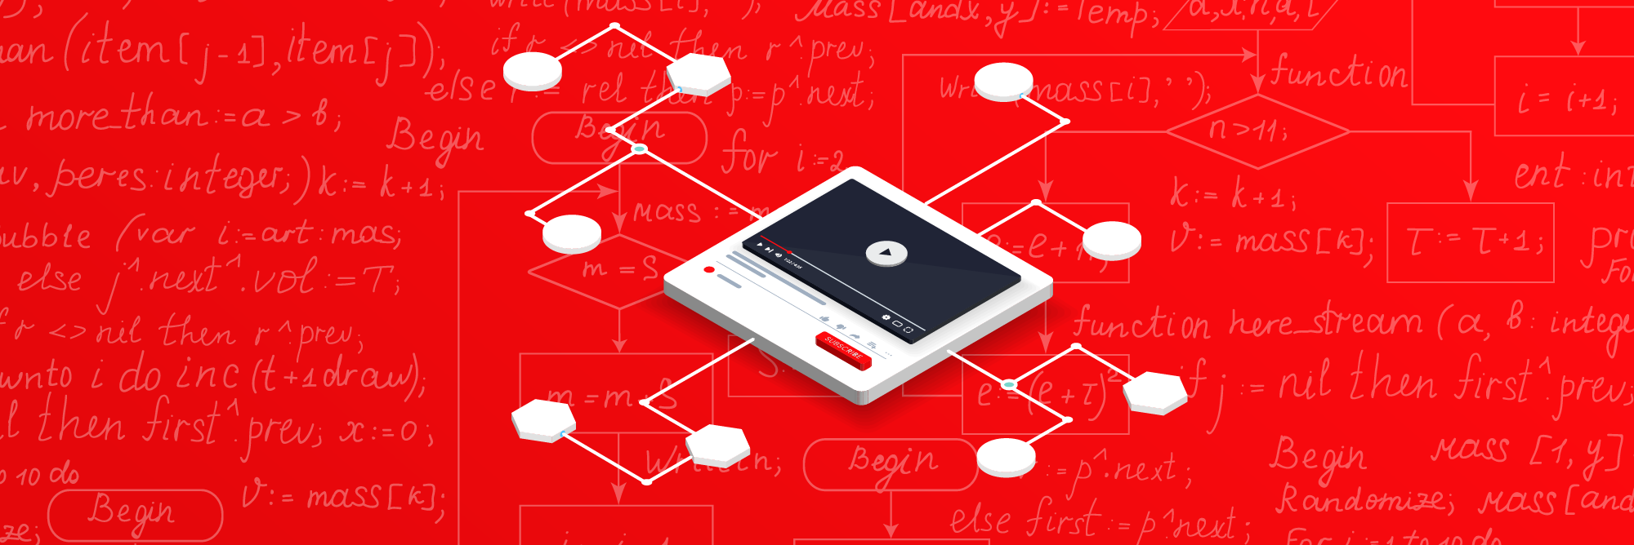
2012: Algorithms and deep learning
Piracy is in decline due to new business models, but revenues are still stagnating

Slide 21
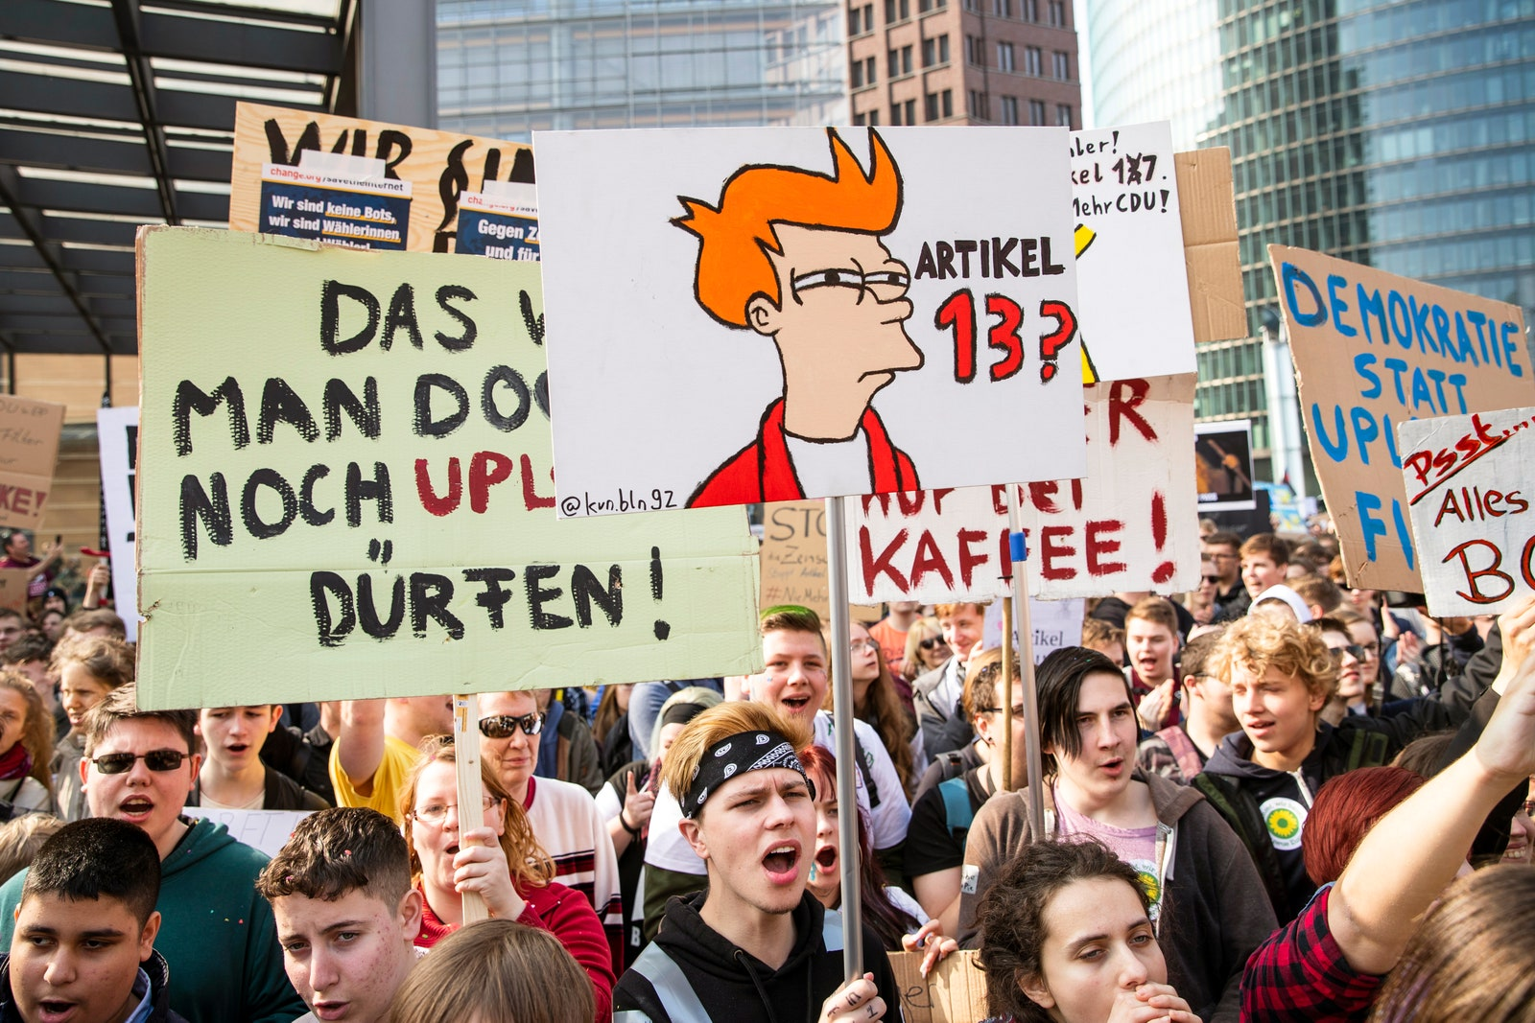
2019: CDSM Directive (EU)
Public protests in EU, institutional resistance (academic, industry)
Rhetoric -> Big Tech is profiting from unauthorised hosting of infringing content
Rhetoric -> New technologies can achieve automated enforcement and prevent infringing material from being uploaded (’upload filters’, ‘YouTube tax’, ‘censorship machines’)

Slide 22
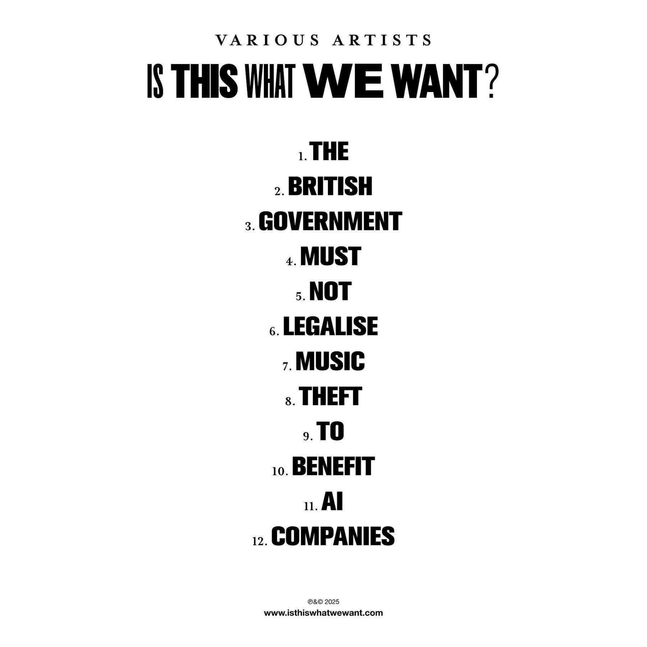
2025: AI protests
Symbolic/artistic protests
Over 1,000 artists release a ‘silent’ album (Is This What We Want)
‘Make It FAIr’ campaign
Online petitions, anti-AI groups, AI ‘slop’, clankers

Slide 23
Mid 00s – Position mapping
Maximalist
Minimalist
Abolitionist
? AI companies ? – some of them maybe!
Rightsholders (and creators)
Platforms and users

Slide 24
Closing thoughts
Changing targets: individual users, rogue platforms, the ‘open’ internet, Big Tech, AI developers
Changing concerns: loss of sales, loss of control, loss of culture/creativity
The law-making process is not neutral
Music often makes up a disproportionate amount of the history of modern copyright
US-centric narrative
Evidence is important… and so is language!
If every major change to copyright policy causes protest, what is its legitimacy in the digital environment?

Slide 25
Next week…
Feeling lost? Don’t worry! Copyright basics will begin next week.
Authorship, ownership and subject-matter (21 January, Adam Smith 584)
Any questions/concerns, email me and/or contact me for an office hour slot

